Slide 1
Exposé

Slide 2
What is an exposé?
Advantages of writing an exposé
Structure/ key elements
Checklist for writing an Exposé
Notes:
Here you can introduce the students to the presentation’s topic.
The goal is to give an overview about what is an exposé and how to write one.

Slide 4

1. What is an exposé?
Work plan for a writing project.
Summarizes preliminary research; serves as a guide.
It is an intermediate step.
It is not a final timetable. Changes may occur.
Use scientific language.
Notes:
Auf dieser Folie beginnen wir, das Thema Exposé vorzustellen.
Es soll als Leitfaden dienen und helfen, die Arbeitsschritte zu organisieren.
Was ist ein Exposé?
Ein Arbeitsplan für ein Schreibprojekt.
Es fasst Ihr vorläufiges Forschungsdesign zusammen und leitet Sie beim Schreiben Ihres Forschungsaufsatzes an.
Es ist ein Zwischenschritt.
Es kann vor akademischen Hausarbeiten, Master- und Doktorarbeiten geschrieben werden.
Es handelt sich nicht um einen endgültigen Zeitplan.
Änderungen sind möglich, sollten aber mit dem zuständigen Professor besprochen werden.
Man sollte eine wissenschaftliche, akademische Sprache verwenden.
Wichtig: Bitte beachtet besonders den Zusammenhang des Exposés mit dem Leuphana Semestermodul Problematisierung von Wissen: Kritisches Denken.

Slide 5
2. Advantages of writing an exposé
Notes:
Suggested activity:
Before showing the slide content, you can ask your students what are the advantages of writing an exposé according to their opinion.
Ask the group if anyone uses other ways of organising their work beforehand.

Slide 6

2. Advantages of writing an exposé
Is state of research is sufficient to deal with the planned research question?
Saves time;
Clear structure;
Overview of problems or areas of improvement.
Writing an exposé involves dedicating time to preliminary reading and freewriting.
Notes:
Advantages of writing an exposé
Makes it clear whether the state of research is sufficient to deal with the planned research question;
It will save you time in the future;
Allows you to clearly structure your work;
It gives you an overview of possible problems and areas for improvement.

Slide 7
3. Structure / Key elements
Exposés’ structure might vary from subject to subject.
Commonly it includes the elements listed below (Leuphana Writing Center, 2020):
Introduction (issue/problem/topic)
Preliminary research question/main argument/ (hypo)thesis
Relevance and (potential) new insight, contribution (theoretical, methodological, etc.), implications for researchers (and practitioners).
Context, framework, other perspectives, hypotheses, theories.
Literature review
Data/texts/artefacts/cases.
Methods (reasons for choosing these methods, potential limitations, etc.).
Notes:
Here is an example of an exhibition structure provided by Leuphana's writing centre.
Please emphasize that the structure presented here is only an example. The professors have the final say on the structure they should follow.

Slide 8

3. Structure / Key elements example from Leuphana Semester
Notes:
Auf den folgenden Folien wird der Aufbau eines Exposés anhand eines Beispiels aus dem Leuphana Semester kurz vorgestellt.
Bitte vergisst nicht, noch einmal zu betonen, dass dies nur ein Beispiel ist. Bitten der Studierenden, sich immer bei ihren Professoren zu erkundigen, welche Struktur sie einhalten sollten.

Slide 9

3. Structure / Key elements example from Leuphana Semester
Cover sheet (general information)
University
Semester
Module
Seminar
Cover sheet (personal details)
Your name
E-mail address of Leuphana
Enrollment number
Degree program and semester
Notes:
In this slide we have an image of the example of exposé provided by Leuphana Semster.
Ideally, tutors should follow the items, identifying and explaining their function and allowing the group to ask questions and clarify possible queries.

Slide 10

3. Structure / Key elements example from Leuphana Semester
Overview of the topic
Body
Overview of the topic
Research question
Objectives
Work steps
Conclusion
Reference
Personal introduction to the topic
Research question and objectives
Notes:
In this slide we have an image of the example of exposé provided by Leuphana Semster.
Ideally, tutors should follow the items, identifying and explaining their function and allowing the group to ask questions and clarify possible queries.

Slide 11
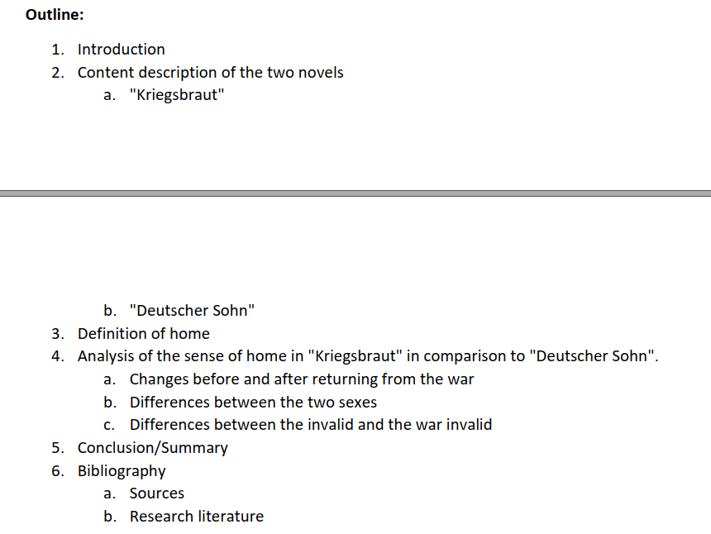
3. Structure / Key elements example from Leuphana Semester
Outline what your work will look like
Indicate the steps you will take for your research
Notes:
In this slide we have an image of the example of exposé provided by Leuphana Semster.
Ideally, tutors should follow the items, identifying and explaining their function and allowing the group to ask questions and clarify possible queries.

Slide 12

3. Structure / Key elements example from Leuphana Semester
Bibliography and References
Notes:
In this slide we have an image of the example of exposé provided by Leuphana Semster.
Ideally, tutors should follow the items, identifying and explaining their function and allowing the group to ask questions and clarify possible queries.

Slide 13
3. Structure / Key elements
More on Exposés
https://www.youtube.com/watch?v=KCqgErJbeXY
https://www.ar.tum.de/fileadmin/w00bfl/www/06_Promotion/180801_Guildelines_Expose.pdf
https://sts.univie.ac.at/fileadmin/user_upload/i_sts/Studium/Master_STS/05_Services_for_current_students/Master_Thesis/Guidelines_for_Writing_a_Master_Thesis_Expose.pdf
https://cccp.uni-koeln.de/sites/cccp/Lehre/How_to_write_an_expose.pdf
How to exposé
&
2 examples (in german)
Notes:
Here we bring you some links that contain more information and examples about exposés.
Please alert the group to the fact that such links are not from Leuphana, so for them to take the content only as an example.

Slide 14
4. Checklist for writing an exposé
Does your exposé for a term paper contain
the working title of the writing project with the research question,
the preliminary outline of the paper and
a likewise preliminary introduction with
the problem,
the research question,
and the aim of the work, as well as
its structure and- its sources?
Notes:
On this page, we present a checklist from Bielefeld University (https://www.uni-muenster.de/imperia/md/content/promotionskolleg_sprachwissenschaft/leitfaden_zum_verfassen_eines_expos__s.pdf ) that you can use to check whether your exposé is well structured. This checklist was recommended by the Leuphana Writing Centre in the document "How to Exposé".
Suggested exercise: Take this opportunity to ask the students what else should be on this list. Or how they would control the quality and structure their own exposé.

Slide 15
4. Checklist for writing an exposé
2. Your exposé for a thesis or dissertation provides information about
- The problem of the writing project,
- the current state of research on the topic,
- the research question of the thesis,
- the author's research interests,
- the aim or the hypothesis underlying the work,
- the theory(s) to be referred to,
- the method(s) to be used,
- the sources or material to be used,
- the preliminary outline, and
- the timetable until the deadline?
Notes:
On this page, we present a checklist from Bielefeld University (https://www.uni-muenster.de/imperia/md/content/promotionskolleg_sprachwissenschaft/leitfaden_zum_verfassen_eines_expos__s.pdf ) that you can use to check whether your exposé is well structured. This checklist was recommended by the Leuphana Writing Centre in the document "How to Exposé".
Suggested exercise: Take this opportunity to ask the students what else should be on this list. Or how they would control the quality and structure their own exposé.

Slide 16
WEITERE BEISPIELE
Notes:
Tutors: You can use this moment to show further examples of exposés created by Leuphana or by yourselves.

